Slide 1
Decision tree using c4.5 algorithm
Decision trees remain popular subjects in the realm of data science today.
The most popular traditional decision tree method in this case is ID3, although it has limitations.
The dataset must not include any missing data, the attributes must have nominal values, and the method must avoid over fitting.
Here, ID3 creator Ross Quinlan made some adjustments to address these inefficiencies and developed a new algorithm known as C4.5.
Now, the algorithm can build more comprehensive models that take continuous data into account and can deal with missing data.

Slide 2
Difference between
Algorithm | Algorithm Splitting Criteria | Algorithm manages Attribute types | Algorithm for Pruning Strategy | Detection of Outlier | Missing values are managed | Invented By
ID3 | Information Gain | Discrete values | No pruning is done | No pruning is done | No | Ross Quinlan
C4.5 | Gain Ratio | Continuous and Discrete values | Error Based pruning is used | Error Based pruning is used | Yes | Ross Quinlan
Discrete Variable | Continuous Variable
whose value is obtained by counting. | whose value is obtained by measuring.
Examples: Number of planets around the Sun Number of students in a class | Examples: Number of stars in the space Height or weight of the students in a class
Range of specified numbers is finite. | Range of specified numbers is infinite.
It assumes a distinct or a separate value. | It assumes any value between two values.

Slide 3
Pruning
Although the Decision Tree in our initial example is quite straightforward, this is not always the case when the dataset is large and there are several variables to take into account.
Pruning is necessary in this situation. Pruning is the elimination of branches from our decision tree that we feel do not significantly add to our decision-making process.
Assume that the variable Vehicle in our example data is related to or a derivative of the condition Money when the value is Rich. When a vehicle is available, we use it to go shopping; but, if one is not, we use another mode of transportation. But ultimately, we go shopping.
This suggests that the Vehicle variable is not particularly important and can be disregarded when building a decision tree.
With the help of the notion of pruning, we may prevent over fitting in regression or classification models such that, when creating a model for a short sample of data, measurement errors are not taken into account.

Slide 4
Pseudocode of C4.5 algorithm
The data mining pseudocode for the C4.5 method:
Note the base first.
Find the normalized information gain ratio by dividing between each characteristic X.
Assume that X has the maximum normalized information gain of all the attributes.
Make a decision node that divides based on the X characteristic.
Repeat the process for the sub-lists created by separating the property X, and then include these nodes as the node's children.

Slide 5
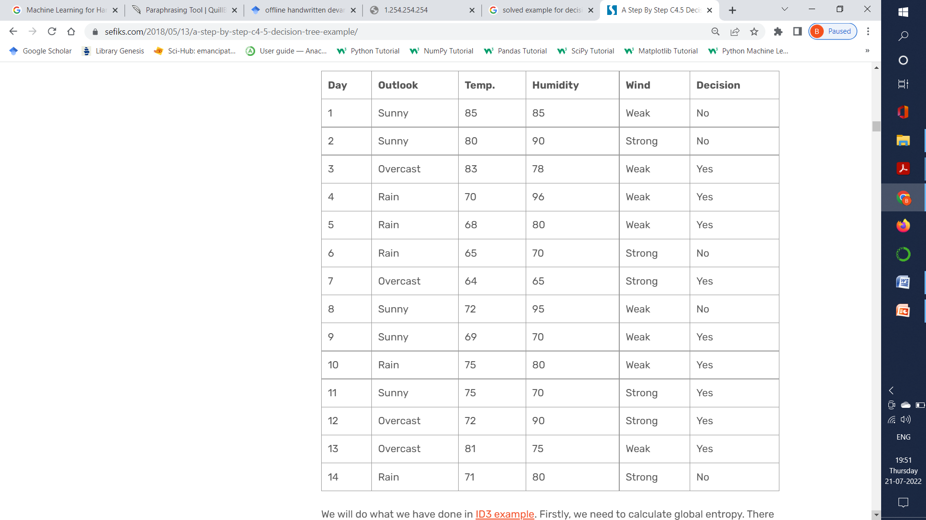
Dataset for implementation

Slide 6
Implementation of C4.5 Algorithm
For the upcoming dataset, we'll make a decision table.
It provides information on the considerations that went into the 14 days of outdoor games.
The columns for temperature and humidity are different because they feature continuous values rather than nominal ones.
Same as ID3 algorithm. Firstly, we have to calculate global entropy.
There are 14 examples:
9 instances refer to YES decision and 5 instances refer to NO decision.
Entropy(Decision) = ∑ – p(I) . log₂p(I)
= – p(Yes) . log₂p(Yes) – p(No) . log₂p(No)
= – (9/14) . log₂(9/14) – (5/14) . log₂(5/14) = 0.940
In ID3 algorithm, we have calculated gains for each attribute.
Here, we have to calculate gain ratios instead of gains.
GainRatio(A) = Gain(A) / SplitInfo(A)
SplitInfo(A) = -∑ |Dj|/|D| x log₂|Dj|/|D|

Slide 7
Wind Attribute
Wind is a nominal attribute and its possible values are Weak and Strong.
Gain(Decision,Wind) = Entropy(Decision) – ∑ ( p(Decision|Wind). Entropy(Decision|Wind) )
Gain(Decision, Wind) = Entropy(Decision) – [ p(Decision|Wind=Weak) . Entropy(Decision|Wind=Weak) ] + [ p(Decision|Wind=Strong) . Entropy(Decision|Wind=Strong) ]
There are 8 Weak wind instances(2-No and 6-Yes)
Entropy(Decision|Wind=Weak) = – p(No) . log₂p(No) – p(Yes) . log₂p(Yes)
= – (2/8) . log₂(2/8) – (6/8) . log₂(6/8) = 0.811
There are 6 Strong wind instances(3-No and 3-Yes)
Entropy(Decision|Wind=Strong) = – (3/6) . log₂(3/6) – (3/6) . log₂(3/6) = 1
Gain(Decision, Wind) = 0.940 – (8/14).(0.811) – (6/14).(1) = 0.940 – 0.463 – 0.428 = 0.049
There are 8 decisions for Weak wind, and 6 decisions for Strong wind.
SplitInfo(Decision, Wind) = -(8/14).log₂(8/14) – (6/14).log₂(6/14) = 0.461 + 0.524 = 0.985
GainRatio(Decision, Wind) = Gain(Decision, Wind) / SplitInfo(Decision, Wind)
= 0.049 / 0.985 = 0.049

Slide 8
Outlook Attribute
Outlook is a nominal attribute and its possible values are Sunny, Overcast and Rain.
Gain(Decision, Outlook) = Entropy(Decision) – ∑ ( p(Decision|Outlook) . Entropy(Decision|Outlook) )
Gain(Decision, Outlook) = Entropy(Decision) – p(Decision|Outlook=Sunny) . Entropy(Decision|Outlook=Sunny) – p(Decision|Outlook=Overcast) . Entropy(Decision|Outlook=Overcast) – p(Decision|Outlook=Rain) . Entropy(Decision|Outlook=Rain)
There are 5 Sunny instances(3-No and 2-Yes)
Entropy(Decision|Outlook=Sunny) = – p(No) . log₂p(No) – p(Yes) . log₂p(Yes)
= -(3/5).log₂(3/5) – (2/5).log₂(2/5)= 0.441 + 0.528 = 0.970
There are 4 Overcast instances(0-No and 4-Yes)
Entropy(Decision|Outlook=Overcast) = -(0/4).log₂(0/4) – (4/4).log₂(4/4) = 0
There are 5 Rain instances(2-No and 3-Yes)
Entropy(Decision|Outlook=Rain) = -(2/5).log₂(2/5) – (3/5).log₂(3/5)= 0.528 + 0.441 = 0.970

Slide 9
Continue of Outlook attribute
Gain(Decision, Outlook) = 0.940 – (5/14).(0.970) – (4/14).(0) – (5/14).(0.970) – (5/14).(0.970) = 0.246
There are 5 instances for Sunny, 4 instances for Overcast and 5 instances for Rain
SplitInfo(Decision, Outlook) = -(5/14).log₂(5/14)-(4/14).log₂(4/14)-(5/14).log₂(5/14) = 1.577
GainRatio(Decision, Outlook) = Gain(Decision,Outlook)/SplitInfo(Decision,Outlook) = 0.246/1.577 = 0.155
Humidity Attribute
Humidity is an exception since it is a constant property.
Continuous values must be transformed into nominal values.
The binary split proposed by C4.5 is based on a threshold value.
Threshold should be set at a level that maximizes the benefit for that feature.
Now we have to first order humidity values from lowest to highest.

Slide 10
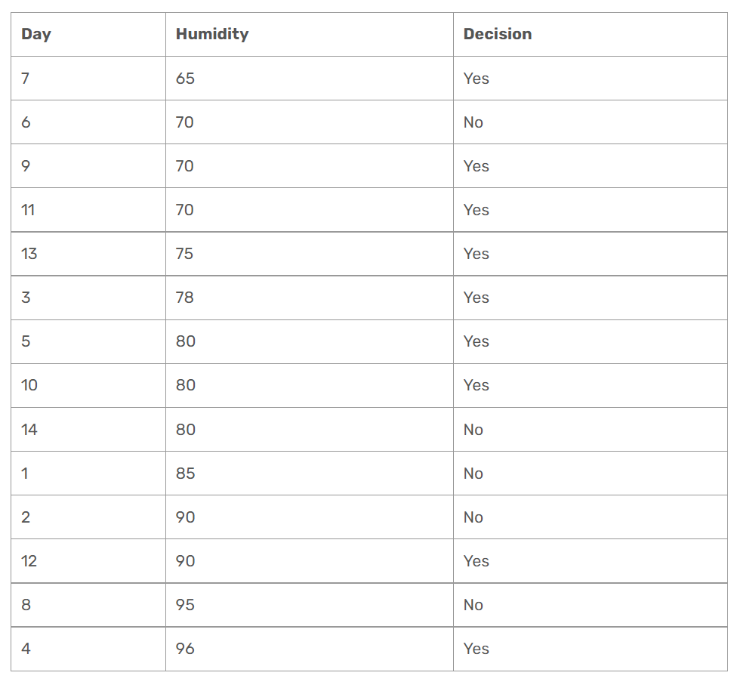

Slide 11
In order to divide the dataset into instances less than or equal to the current value and instances larger than the current value, we must loop over all humidity values.
For each stage, we would figure out the gain or gain ratio.
The threshold would be the value that maximizes the benefit.
Check 65 as a threshold for humidity
Entropy(Decision|Humidity<=65) = – p(No) . log₂p(No) – p(Yes) . log₂p(Yes)
= -(0/1).log₂(0/1) – (1/1).log₂(1/1) = 0
Entropy(Decision|Humidity>65) = -(5/13).log₂(5/13) – (8/13).log₂(8/13)
= 0.530 + 0.431 = 0.961
Gain(Decision, Humidity<> 65) = 0.940 – (1/14).0 – (13/14).(0.961) = 0.048
* The statement above refers to that what would branch of decision tree be for less than or equal to 65, and greater than 65. It does not refer to that humidity is not equal to 65!
SplitInfo(Decision, Humidity<> 65) = -(1/14).log₂(1/14) -(13/14).log₂(13/14) = 0.371
GainRatio(Decision, Humidity<> 65) = 0.126

Slide 12
Check 70 as a threshold for humidity
Entropy(Decision|Humidity<=70) = – (1/4).log₂(1/4) – (3/4).log₂(3/4) = 0.811
Entropy(Decision|Humidity>70) = – (4/10).log₂(4/10) – (6/10).log₂(6/10) = 0.970
Gain(Decision, Humidity<> 70) = 0.940 – (4/14).(0.811) – (10/14).(0.970)
= 0.940 – 0.231 – 0.692 = 0.014
SplitInfo(Decision, Humidity<> 70) = -(4/14).log₂(4/14) -(10/14).log₂(10/14) = 0.863
GainRatio(Decision, Humidity<> 70) = 0.016
Check 75 as a threshold for humidity
Entropy(Decision|Humidity<=75) = – (1/5).log₂(1/5) – (4/5).log₂(4/5) = 0.721
Entropy(Decision|Humidity>75) = – (4/9).log₂(4/9) – (5/9).log₂(5/9) = 0.991
Gain(Decision, Humidity<> 75) = 0.940 – (5/14).(0.721) – (9/14).(0.991)
= 0.940 – 0.2575 – 0.637 = 0.045
SplitInfo(Decision, Humidity<> 75) = -(5/14).log₂(4/14) -(9/14).log₂(10/14) = 0.940
GainRatio(Decision, Humidity<> 75) = 0.047

Slide 13
Same as previous calculation examples all values of humidity are computed for threshold and find out the following results:
Gain(Decision, Humidity <> 78) =0.090, GainRatio(Decision, Humidity <> 78) =0.090
Gain(Decision, Humidity <> 80) = 0.101, GainRatio(Decision, Humidity <> 80) = 0.107
Gain(Decision, Humidity <> 85) = 0.024, GainRatio(Decision, Humidity <> 85) = 0.027
Gain(Decision, Humidity <> 90) = 0.010, GainRatio(Decision, Humidity <> 90) = 0.016
Gain(Decision, Humidity <> 95) = 0.048, GainRatio(Decision, Humidity <> 95) = 0.128
Because humidity cannot be more than this value, ignored threshold value of 96 in this case.
As can be seen, gain is at its highest when humidity threshold is set at 80.
This means that in order to add a branch to our tree, we must compare humidity to 80 and other nominal properties.

Slide 14
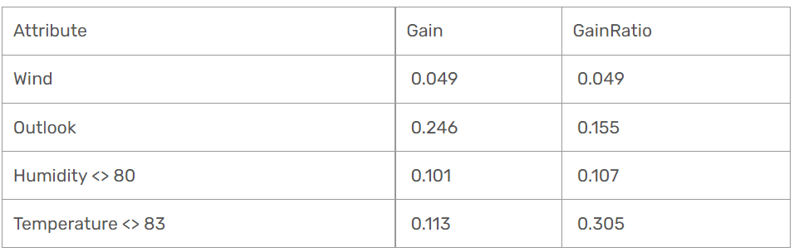
The temperature attribute is also continuous.
The following decision rule maximizes gain and gain ratio for all potential split points when binary split is applied on temperature.
Gain(Decision, Temperature>83) = 0.113,
GainRatio(Decision, Temperature>83) = 0.305.
The computed gain and gain ratios will be presented below
Outlook attribute includes gain ratio and maximal gain. This indicates that the outlook decision should be placed at the decision tree's root.

Slide 15
Outlook will be the root node if we utilise the gain measure since it has the highest gain value.
Temperature, on the other hand, will be the root node if we utilize the gain ratio measure since it has the largest gain ratio value. Here, I choose to employ gain in a manner akin to ID3.
Please attempt to construct a C4.5 decision tree based on the gain ratio measure as homework.
Then, using the same procedures as ID3, we would generate the following decision tree.
The root node contains Outlook.
We should now consider our options for various perspective kinds.
Outlook= Sunny
For higher than 80 and less than or equal to 80, we divided the humidity. Surprisingly, when the forecast is sunny and the humidity is above 80, the choice would be No.
Similarly, the answer would be Yes if the humidity for a sunny forecast was less than or equal to 80.

Slide 16
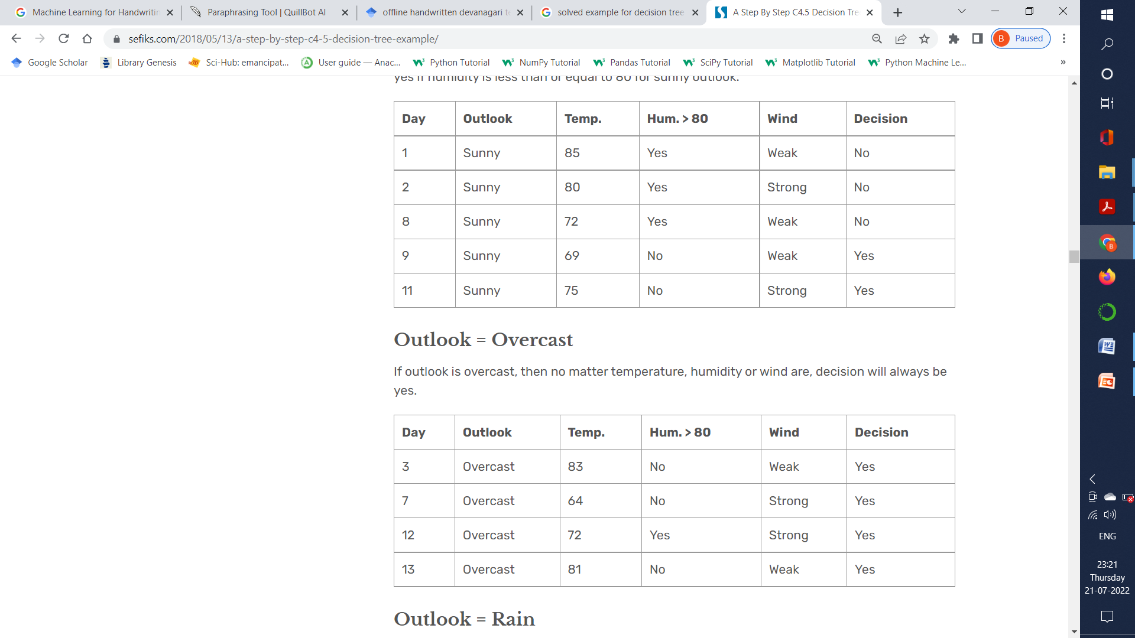

Slide 17
